Slide 1

Privacy-Preserving Deep Learning NLP Models for Cancer Registries
01
Submitted by:
Mohammad Aman Ullah Khan
ID: 19301139, Course: CSE 438,
Department of Computer Science & Engineering.
Submitted to: Mr. Annajiat Alim Rasel Sir.

Slide 2
Table of contents
01
02
03
04
05
06
07
08
09
10
11
12
02
Research Background
Introduction
Deep learning & NLP
in Medical contexts
Challenges in
Data Sharing
Data Collection
& Study Area
Algorithms & Models
Privacy issues in
DL/NLP models
Result & Model Selection
Conclusion
References
Model Validation
& Variability
Future Implications
and Research

Slide 3

Introduction
03
1. Deep Learning & NLP in Cancer Research
Revolutionizing data analysis and insight extraction.
Processing unstructured data for pattern identification.
2. Importance of Privacy in Medical Data
Critical for patient data confidentiality.
Essential for legal, ethical, and trust compliance.

Slide 4
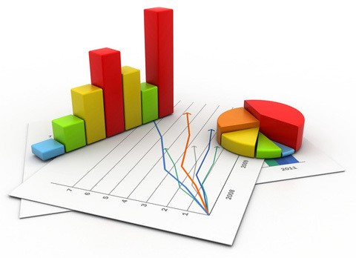
Research Background
04
1. Evolution of NLP Models in Medical Research
Progressive enhancement in text analysis capabilities.
Improved accuracy in patient data interpretation.
2. Significance of Deep Learning in Cancer Registries
Enhanced data processing and analysis.
Key role in accurate diagnosis and treatment strategies.

Slide 5

Challenges in Data Sharing
05
1. Privacy Concerns with Sensitive Medical Data
Risks of unauthorized access and data breaches.
Importance of robust privacy safeguards.
2. Regulatory and Ethical Considerations
Navigating complex healthcare regulations
Balancing data utility and ethical responsibilities.
3. Data Sharing and Collaboration Barriers
Technical and logistical challenges in data interoperability.
Balancing collaboration with data ownership rights.

Slide 6
Deep Learning & NLP in Medical Contexts
06
1. Enhanced Diagnostic Accuracy
Leveraging DL & NLP for precise disease detection and prognosis.
2. Advancements in Cancer Research
Innovations in automated data extraction and analysis.
Contribution to personalized cancer treatment.
3. Efficient Data Management
Streamlining the processing of vast medical datasets.

Slide 7

Data Collection & Study Area (01)
07
1. Methodology of Data Collection
Description of data collection techniques and sources.
Data preprocessing steps for quality assurance.
2. Geographical & Demographic Focus
Identification of the geographic areas included in the study.
Consideration of demographic factors such as age, gender, and ethnicity.
3. Sample Size and Diversity
Explanation of the size and diversity of the dataset.
Ensuring representative data for meaningful analysis.

Slide 8
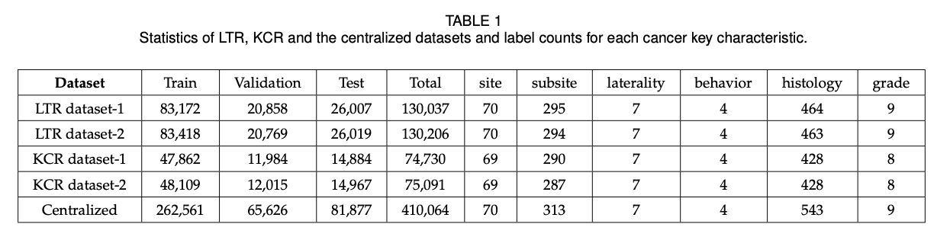
Data Collection & Study Area (02)
08
Description of the datasets used (from the Louisiana Tumor Registry and Kentucky Cancer Registry).
Details on pre-processing and data characteristics:

Slide 9

Privacy issues in DL/NLP models
09
1. Risks of Data Breaches
Threats to patient data confidentiality.
Potential legal and reputational repercussions.
2. Secure Data Handling Practices
Implementing encryption and access controls.
Training personnel in data security protocols.
3. Regulatory Compliance
Meeting healthcare privacy regulations.
Adhering to ethical guidelines for data handling.

Slide 10
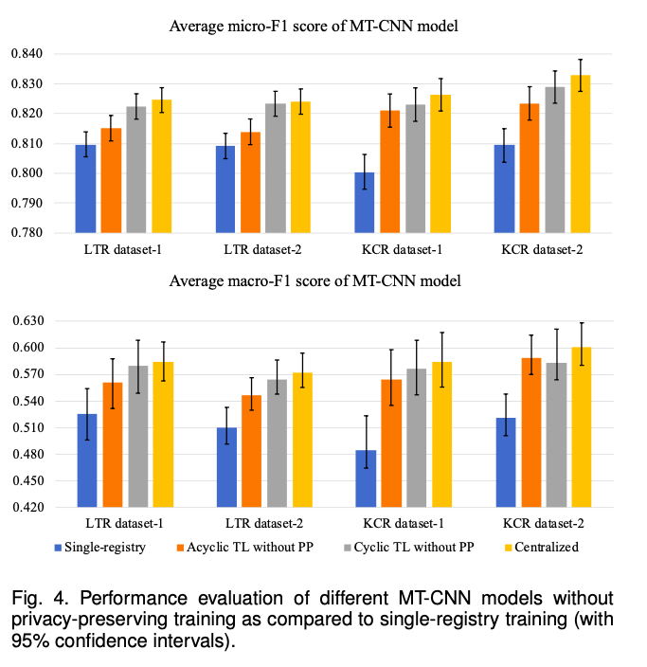
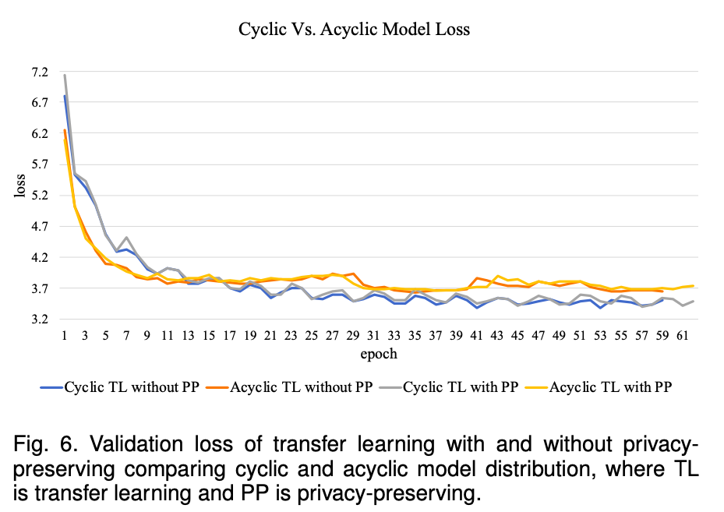
Result & Model Selection
10
Performance comparison of different models.
Criteria for model selection.

Slide 11
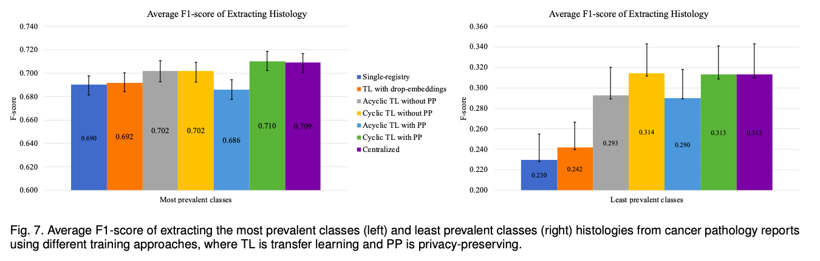
Model Validation & Variability
11
Techniques for validating model accuracy.
Addressing variability in data sets.

Slide 12

Future Implications & Research
12
1. Potential Developments in Privacy-Preserving Models
Evolving privacy-preserving techniques in DL/NLP.
Integration of advanced encryption and secure federated learning.
2. Future Research Directions
Exploring new applications of privacy-preserving models in healthcare.
Investigating novel data sharing paradigms that balance privacy and utility.

Slide 13
References:
13
Privacy-Preserving Deep Learning NLP Models for Cancer Registries. (2021, September 1). IEEE Journals & Magazine | IEEE Xplore. https://ieeexplore.ieee.org/document/9069186
2. A Survey of Text Representation and Embedding Techniques in NLP. (2023). IEEE Journals & Magazine | IEEE Xplore. https://ieeexplore.ieee.org/document/10098736
3. Identifying Security and Privacy Violation Rules in Trigger-Action IoT Platforms With NLP Models. (2023, March 15). IEEE Journals & Magazine | IEEE Xplore. https://ieeexplore.ieee.org/document/9953113
4. A Unified Understanding of Deep NLP Models for Text Classification. (2022, December 1). IEEE Journals & Magazine | IEEE Xplore. https://ieeexplore.ieee.org/document/9801603
5. Clinical Errors From Acronym Use in Electronic Health Record: A Review of NLP-Based Disambiguation Techniques. (2023). IEEE Journals & Magazine | IEEE Xplore. https://ieeexplore.ieee.org/document/10147227

Slide 14
Thanks!
14
Do you have any questions?

